Slide 1
Abduction & Inference
COMP 4230
David J Stucki
Fall 2024

Slide 2
Alerts
Read Moroney Chapter 8
Read Larson Chapter 15

Slide 3
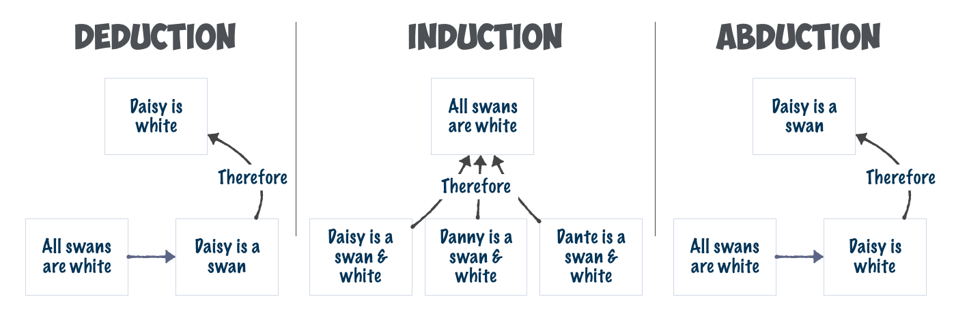
Reasoning & Inference
There have historically been three flavors

Slide 4
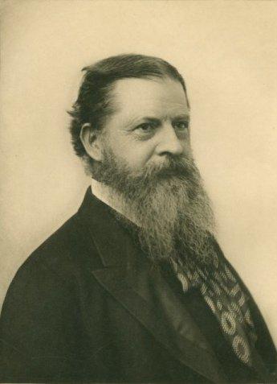
Charles Sanders Peirce (1839-1914)
"Looking out my window this lovely spring morning, I see an azalea in full bloom. No, no! I don't see that; though that is the only way I can describe what I see. That is a proposition, a sentence, a fact; but what I perceive is not proposition, sentence, fact, but only an image, which I make intelligible in part by means of a statement of fact. This statement is abstract; but what I see is concrete. I perform an abduction when I so much as express in a sentence anything I see. The truth is that the whole fabric of our knowledge is one matted felt of pure hypothesis confirmed and refined by induction. Not the smallest advance can be made in knowledge beyond the stage of vacant staring, without making an abduction at every step."

Slide 5
Guess what I'm thinking...
“We are extraordinarily good at hypothesizing, which is, to Peirce's mind, not explainable by mechanics but rather by an operation of mind which he calls, for lack of another explanation, instinct. We guess, out of a background of effectively infinite possibilities, which hypothesis seems likely or plausible.”
—Larson, p. 161 (The Origin of Inference as Guessing) —
Organize into groups of 3-4 (mix it up)
Discuss the following questions (based on pp. 157-168):
  What is abduction? (agree on a definition as a group)
  Compare it to both deduction and induction. What are the main distinctions?
  What is the role of surprise in abduction? Why is that important?
Discussion

Slide 6
It doesn't all add up!
“If deduction is inadequate, and induction is in adequate, then we
must have a theory of abduction. Since we don't (yet), we can already
conclude that we are not on a path to artificial general intelligence.”
—Larson, p. 173 (Fallacies & Hypotheses) —
Discuss the following questions (based on pp. 168-178)
On p. 173 Larson states that knowledge can only be recovered from data syntactically. What do you think he means by this?
What is a counterfactual (p. 174)? How is this relevant?
Discussion

Slide 7
Magical Inference Engines
“Peirce offered what he called a "vague explanation" of the unreasonable accuracy of our guessing: "There can, I think, be no reasonable doubt that man's mind, having been developed under the influence of the laws of nature, for that reason naturally thinks somewhat after nature's pattern.”
—Larson, pp. 183-4 (Magical Inference Engines) —
Discuss the following questions (based on pp. 178-190)
What does Larson mean by 'bottomless bucket' (p. 178)?
Discuss Umberto Eco's notion of undercoded abduction (pp. 186-7). Why is this important?
Chapter 12 ends with 3 reasons we don't have a fundamental theory. Summarize these and discuss.
Discussion

Slide 8

Eugene Goostman & Replicants
“Voight-Kampff Test”
—Bladerunner, 1982—
Discuss the following questions (pp. 190-203)
  What lesson should we learn from Eugene Goostman (pp. 191-195)
  Compare and contrast the Winograd schemas (pp. 195-200) with the Voight-Kampff test from Bladerunner.
Discussion

